Slide 1

Research Method for Computing and Technology
Presentation on
Smart Citizen Sensing

Slide 2

Abstract
This presentation is based on visual sentiment prediction of citizens
Use of neural network on analysing visual sentiment
Overall prediction is 83.85 % accurate

Slide 3

Citizen sensing
Collecting data from sensor for monitoring purpose
Cheap, quick and precise way of collecting data
Helpful for health care and civil protection
Enhance city’s intelligence, quality of life and other attributes(i.e., environment, education, transportation, etc).

Slide 4

Sentiment Analysis
Definitions:
It is the field that tries to give machines and computer software the ability to understand the emotions of the people.
Categories:
Positive
Neutral
Negative

Slide 5
Sentiment Analysis
Unstructured data collected from web or social media are structured and classified to extract the information about people emotions, preference and ideas.
Helps to monitor the level of citizen’s satisfaction towards the services provided to them
Helps to identify the area where people are satisfied and the area where they aren’t

Slide 6
Sentiment Analysis
Source of Information
Reviews
News
Blogs
Images
Videos
Classifies information on the basis of the polarity as positive, negative or neutral.

Slide 7
Deep Convolutional Neural
Networks
Used for image recognition, Images classifications, face recognition or object detections.
Shared images on social media are used in order to extract data using convolutional neural network.
Images shared in social media can reflect the positive sentiment and negative sentiment.

Slide 8

Visual Sentiment Analysis via Convolutional Neural
Networks
Accuracy is 83.33 percent.
Possible to build the map of the area where citizens are unhappy with the services provided by the government.

Slide 9
Transfer Learning
Definition:
It is a machine learning method where a model developed for a task is reused as the starting point for a model on a second task.

Slide 10
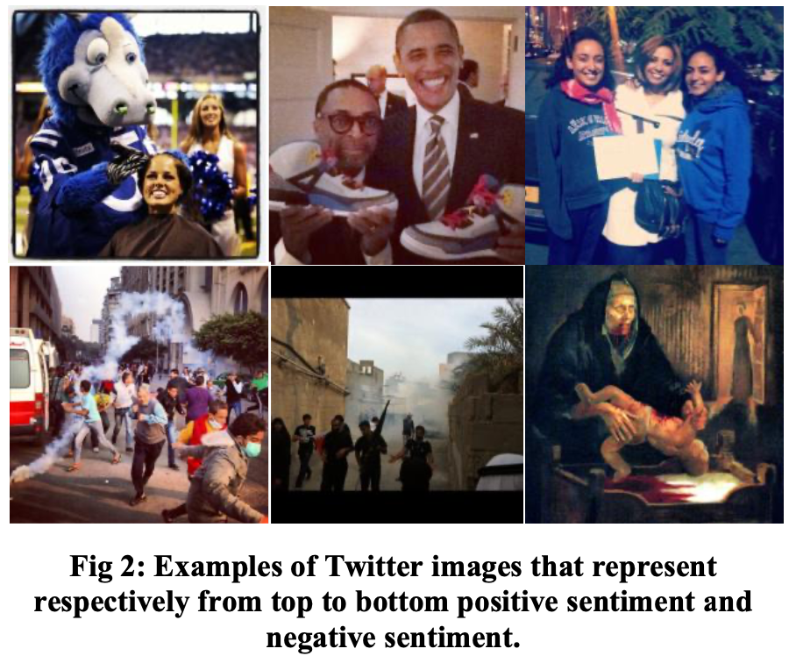

Slide 11

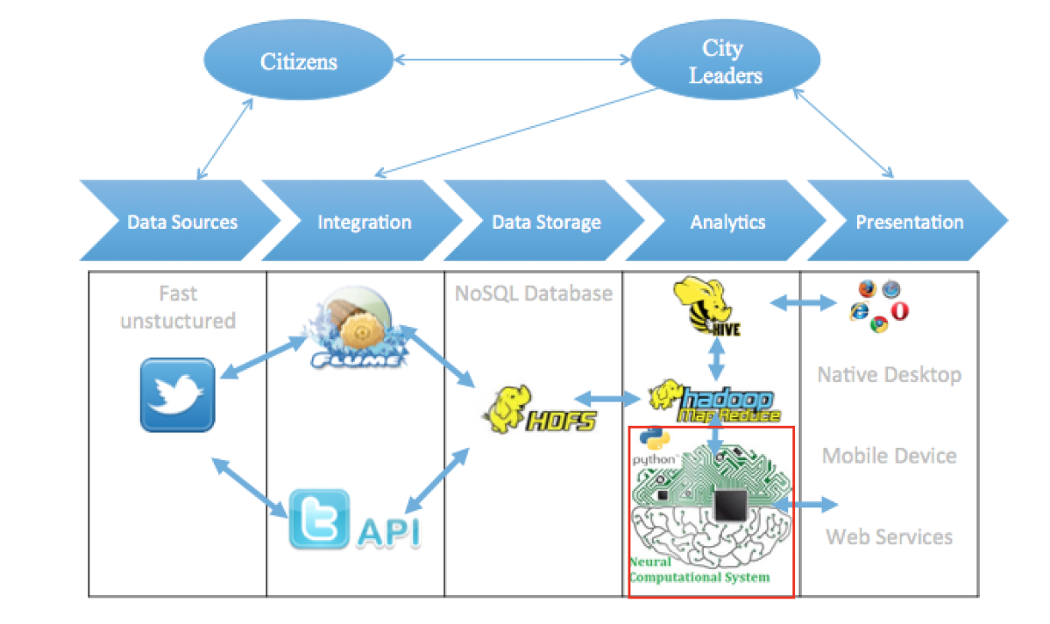
Fig: The proposed architecture for a citizen sensing tool using neural network computation system

Slide 12
Twitter is taken as a tool to collect data as twitter generates big volume of raw data
Then such data are transformed into useful information as shown on figure above.

Slide 13

Firstly, data from twitter are downloaded and loaded into Hadoop using Apache Flume or APIs tools
Then data extracted from twitter are stored in HDFS
Divide large data into block
Data are replicated
MapReduce then transform unstructured data to meaningful data
Finally, data are loaded into CNN which perform sentiment analysis.

Slide 14
Conclusion
Sentiment analysis is the key factor in the development of smart city domain
Visual sentiment are performed with the helps of transfer learning and convolutional Neural Network

Slide 15
!! Thank You !!

